Slide 1
Network Flow
Dr. Siddhaling Urolagin

Slide 2
bipartite graph
A bipartite graph
G = (V, E) is an undirected graph whose node set can be partitioned as
V = X ∪ Y, with the property that every edge e ∈ E has one end in X and the other end in Y.
a matching in a graph G = (V, E) is a set of edges M ⊆ E with the property that each node
appears in at most one edge of M. A set of edges M is a perfect matching
If every node appears in exactly one edge of M.

Slide 3
network flow problems
Determining the size of the largest matching in a bipartite graph G.
network flow problems—that includes the Bipartite
Matching Problem as a special case a polynomial-time
algorithm for a general problem, the Maximum-Flow Problem,
how
this provides an efficient algorithm for Bipartite Matching as well

Slide 4
Maximum-Flow Problem
graphs to model transportation networks a highway system in which the edges are highways and the nodes are interchanges
a computer network in which the edges are links that can carry packets and the nodes are switches
a fluid network in which edges are pipes that carry liquid, and the nodes are junctures where pipes are plugged together capacities on the edges, indicating how much they can carry;
source nodes in the graph, which generate traffic;
Sink (or destination) nodes in the graph, which can “absorb” traffic

Slide 5
Flow Networks
entity that is generated at source nodes, transmitted across edges, and absorbed at sink nodes
that a flow
network is a directed graph G = (V, E) with the following features.
Associated with each edge e is a capacity, which is a nonnegative number that we denote ce.
There is a single source node s ∈ V
There is a single sink node t ∈ V.
other than s and t will be called internal nodes

Slide 6
Example
no edge enters the source s and no edge leaves the sink t
That there is at least one edge incident to each node
all capacities are integers

Slide 7
Defining Flow
We say that an s-t flow is a function f that maps each edge e to a
nonnegative real number
f : E→R+;
the value f (e) intuitively represents the amount of flow carried by edge e

Slide 8
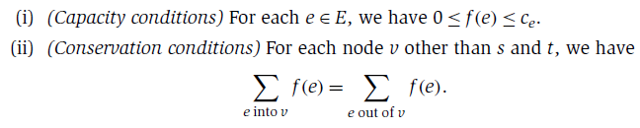
Two properties
A flow f must satisfy the following two
properties

Slide 9



the amount of flow entering
must equal the amount of flow leaving
The value of a flow f , denoted ν(f ), is
defined to be the amount of flow generated at the source

Slide 10

if S ⊆ V, we
conservation condition for nodes v = s, t becomes

Slide 11
The Maximum-Flow Problem
Given a flow network, find a flow of maximum possible value

Slide 12
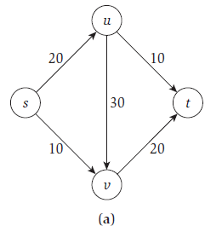
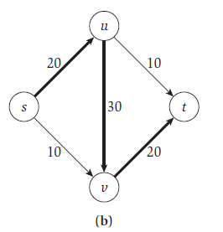
Designing the Algorithm
simple greedy approaches
f (e) = 0 for all e
try to increase the value of f by “pushing” flow along a path from s to t
choose the path consisting of the edges {(s, u), (u, v), (v, t)}
and increase the flow on each of these edges to 20, and leave f (e) = 0 for the other two.
we only set the flow as high as the edge capacities would allow—and the conservation conditions
Now, the value of our flow is 20

Slide 13
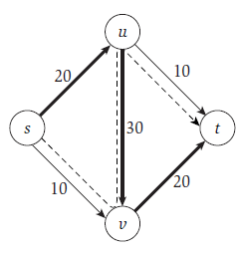
Is this the maximum possible for the graph in the figure?
the answer is no
since it is possible to construct a flow of value 30.
We push 10 units of flow along (s, v); this now
results in too much flow coming into v.
we “undo” 10 units of flow on (u, v);
this restores the conservation condition at v but results in too little
flow leaving u.
we push 10 units of flow along (u, t),
restoring the conservation condition at u.
new kind of augmentation

Slide 14
We can push forward on edges with leftover capacity,
we can push backward on edges that are already carrying flow
to divert it in a different direction
To create residual graph

Slide 15
residual graph
Given a flow network G, and a flow f on G, we define
the residual graph Gf of G with respect to f as follows.
The graph G with the path s, u, v, t used to push the first 20 units of flow
The residual graph of the resulting flow f , with the residual capacity next to each edge. The dotted line is the new augmenting path.
The residual graph after pushing an additional 10 units of flow along the new augmenting path s, v, u, t.

Slide 16
forward edges.
We will call edges included this way forward edges.

Slide 17
backward edges
For each edge e = (u, v) of G on which f (e) > 0, there are f (e) units of
flow that we can “undo” if we want to, by pushing flow backward
we include the edge e’ = (v, u) in Gf , with a capacity of f (e).
direction is reversed

Slide 18
Each edge e in G can give rise to one or two edges in Gf
If 0 < f (e) < ce it results in both
a forward edge and a backward edge being included in Gf
the capacity of an edge in the residual graph as a residual capacity

Slide 19
Augmenting Paths in a Residual Graph
Let P be a simple s-t path in Gf
P does not visit any node more than once
bottleneck(P, f ) is the minimum residual capacity of any edge on P
with respect to the flow f
Augment(f , P), which yields a new flow f’ in G.
The result of augment(f , P) is a new flow f in G,

Slide 20
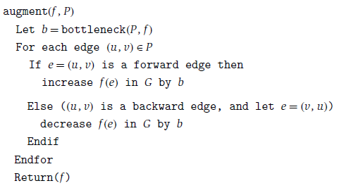

Slide 21
f’ is a flow in G.
Since f’ differs from f only on edges of P, we need to check the capacity
conditions only on these edges.
let (u, v) be an edge of P
if e = (u, v) is a forward edge,
we specifically avoided increasing the flow on e above ce
if (u, v) is a backward edge arising from edge e = (v, u) ∈ E,
Avoided decreasing the flow on e below 0.
bottleneck(P, f ) is no larger than the residual capacity of (u, v).
If e = (u, v) is a forward edge,

Slide 22



then its residual capacity is ce − f (e); thus we have
If (u, v) is a backward edge arising from edge
e = (v, u) ∈ E, then its residual capacity is f (e),
the capacity condition holds

Slide 23
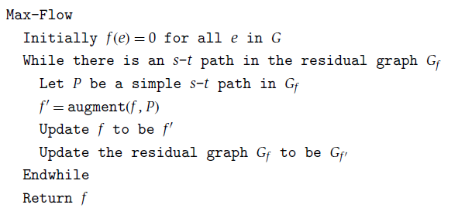
Ford-Fulkerson Algorithm
algorithm to compute an s-t flow in G.

Slide 24
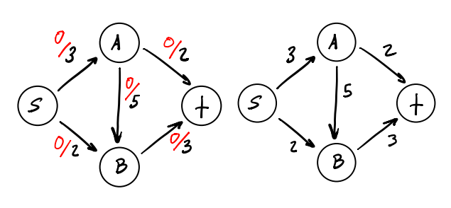
Ford-Fulkerson algorithm example
Initially set the flow along every edge to 0.
Construct a residual graph for this network. It should look the same as the input flow network.

Slide 25
step 1
Initial flow is set to 0.

Slide 26
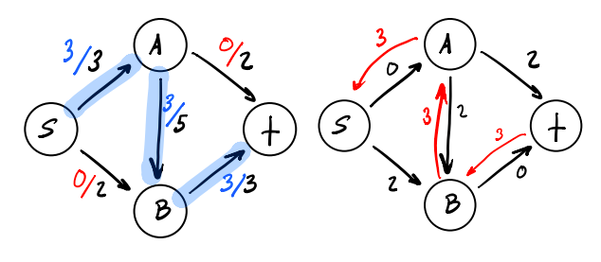
step 2
we can achieve a flow of 3. Update the residual graph

Slide 27
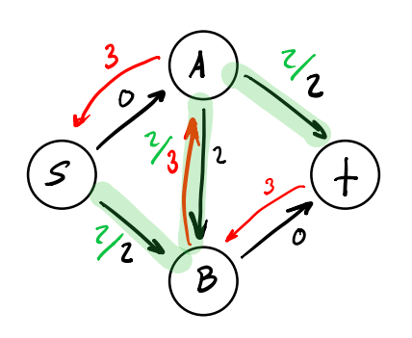
step 3
Search through the updated residual graph for a new s-t path.
we can use a back edge to augment the current flow.
We can decrease the flow along the A-B edge by 2 which will allow us to make use of both edges leading into t

Slide 28
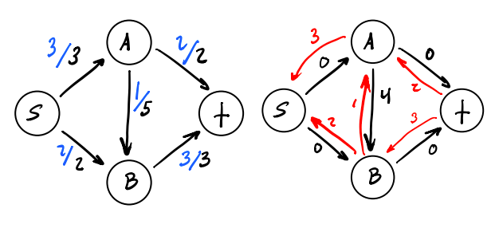
step 4
Augment the current flow with our findings above and update the residual graph.

Slide 29

7.2 Maximum Flows and Minimum Cuts in a Network
Analyzing the Algorithm: Flows and Cuts
flow that is returned by the Ford-Fulkerson
Algorithm has the maximum possible value of any flow in G
one upper bound: the value ν(f ) of
any s-t-flow f is at most
We now use the notion of a cut to develop a much
more general means of placing upper bounds on the maximum-flow value

Slide 30
Dividing the nodes of the graph into two sets, A and B, so that
s ∈ A and t ∈ B.
such division places an upper bound on the maximum possible flow value, since all the flow must cross from A to B somewhere
An s-t cut is a partition
(A, B) of the vertex set V,
so that s ∈ A and t ∈ B
The capacity of a cut (A, B), which we will denote c(A, B), is simply the sum of the capacities of all edges
out of A:

Slide 31

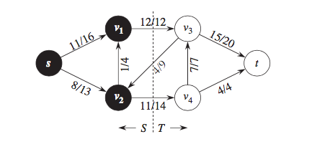
A={s,v1,v2}
B={t,v3,v4}
capacity of a cut (A, B), which we will denote c(A, B)=12+14=26 (upper bound)
The "capacity" of the cut is therefore equal to maximal flow that can cross the cut from the source to the sink.

Slide 32
A={s,v1,v2}
B={t,v3,v4}
V(f) is the flow net flow across the cut
Here v(f)=12-4+11=19

Slide 33

if (A, B) is a cut, then the edges into B are precisely the edges
out of A. Similarly, the edges out of B are precisely the edges into A.
Let f be any s-t flow, and (A, B) any s-t cut. Then

Slide 34

If we set A= V − {t} and B = {t} we have,
sink t has no leaving edges
the amount of flow arriving at the sink.

Slide 35
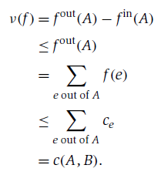
A very useful consequence of is the following upper bound
is that the value of every flow is upper-bounded by the capacity of every cut

Slide 36
any s-t cut in G of some value c∗, we know immediately by
that there cannot be an s-t flow in G of value greater than c∗. Conversely,
if we exhibit any s-t flow in G of some value ν∗, we know immediately by
that there cannot be an s-t cut in G of value less than ν∗

Slide 37
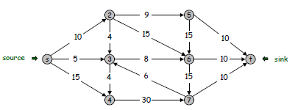
Example on Min Cut
Consider a network as follows

Slide 38
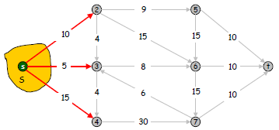
Find the capacity of the cut

Slide 40
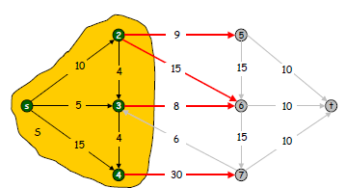
Find the capacity of the cut

Slide 41


Slide 42
Thank you

